Slide 1


WEEKLY MEETING JSL PKS Mandiri Periode 16 Oktober 2023 - 22 Oktober 2023
Technical DevOps Engineer
PT. Infracom Technology

Slide 2
Update health and status of PKS/TKGi Cluster
Update capacity and utilization of TKGi resource
PKS/TKGI release notes
Update any issue that happened a week ago
Any information correlated with PKS/TKGI Cluster

Slide 3
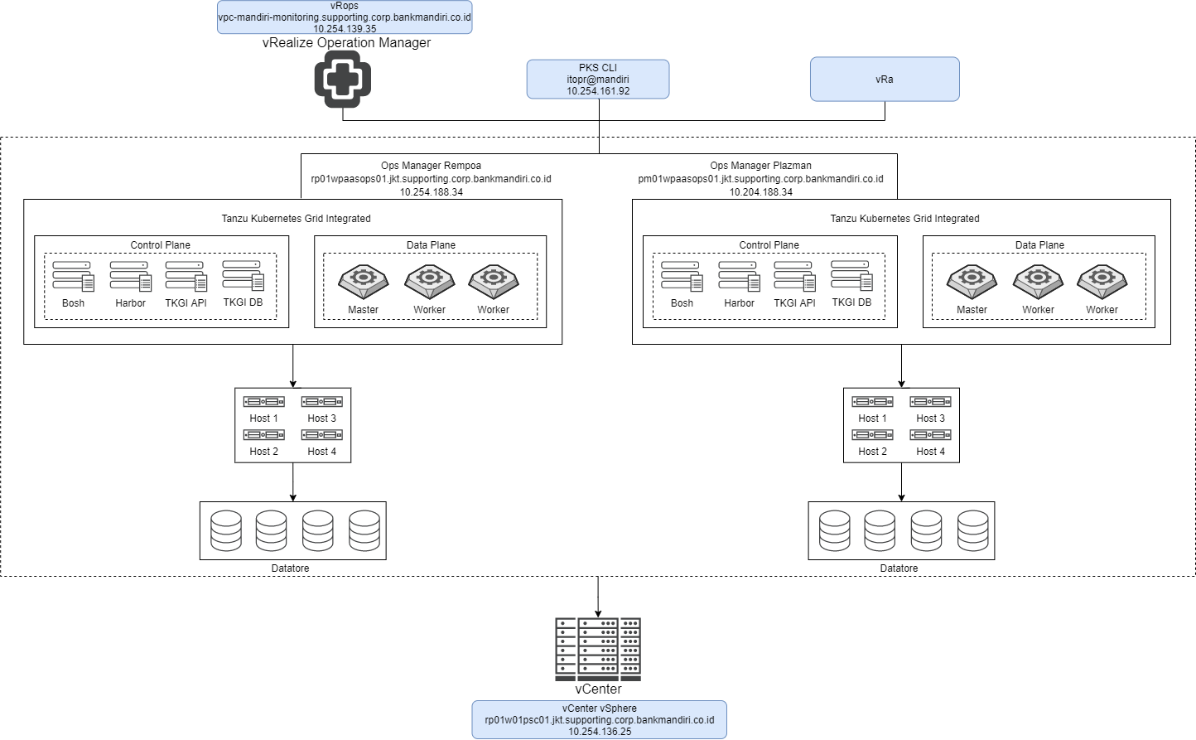
Topologi PKS/TKGI Cluster Prod

Slide 4
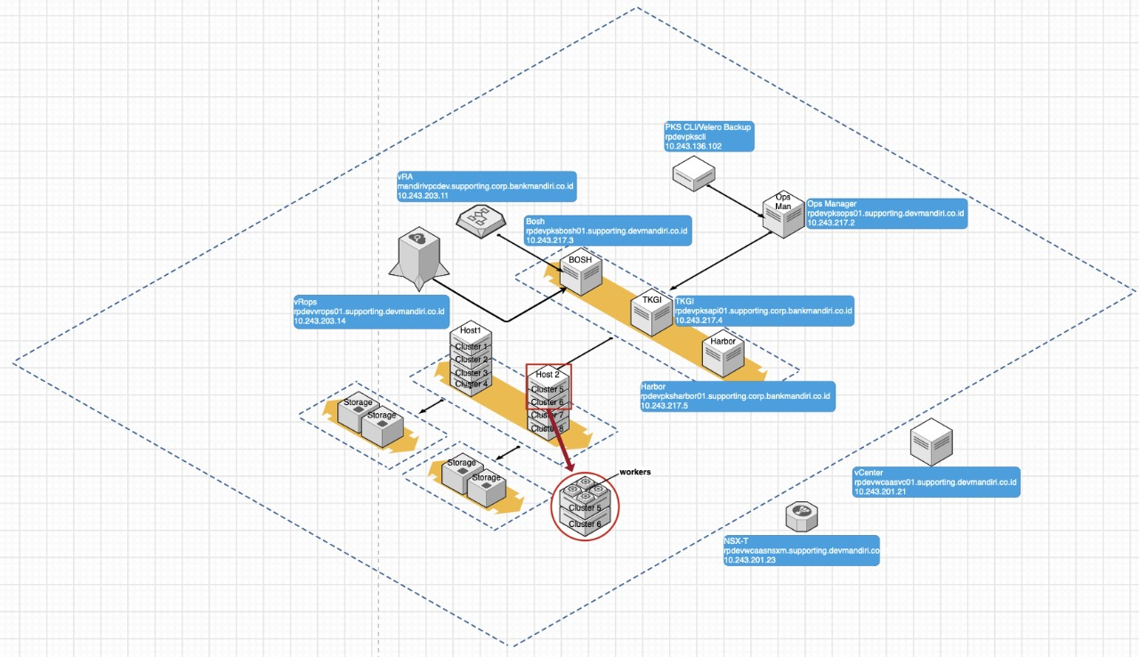
Topologi PKS/TKGI Cluster Dev

Slide 5
Update the health and status of PKS/TKGI Cluster

Slide 6
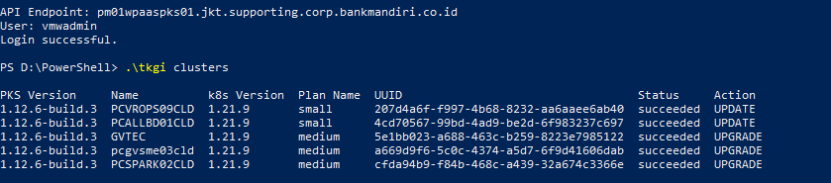
Cluster Kubernetes Plaza Mandiri
Jumlah Cluster : 5 Cluster
Status Cluster : 5 Succeeded

Slide 7
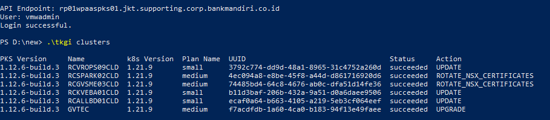
Cluster Kubernetes Rempoa
Jumlah Cluster : 6 Cluster
Status Cluste : 6 Succeeded

Slide 8
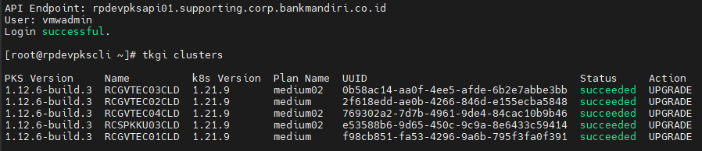
Cluster Kubernetes Rempoa Dev
Jumlah Cluster : 5 Cluster
Status Cluster : 5 Succeeded

Slide 9
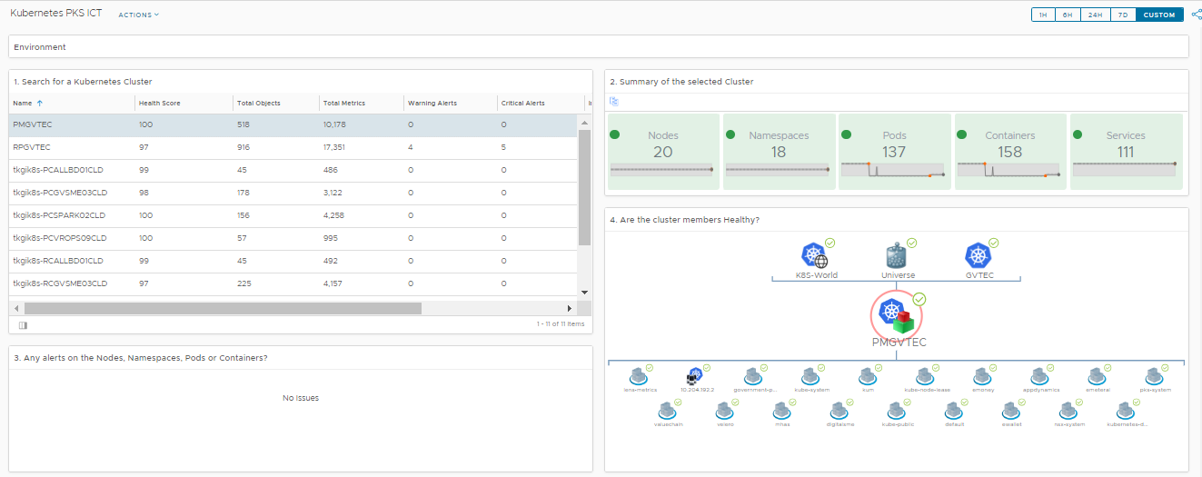
Availability PMGVTEC

Slide 10
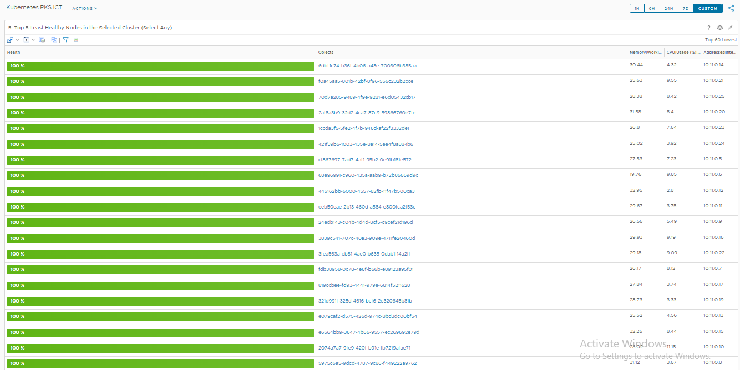
Health Status PMGVTEC
(Time Frame Satu Minggu)

Slide 11
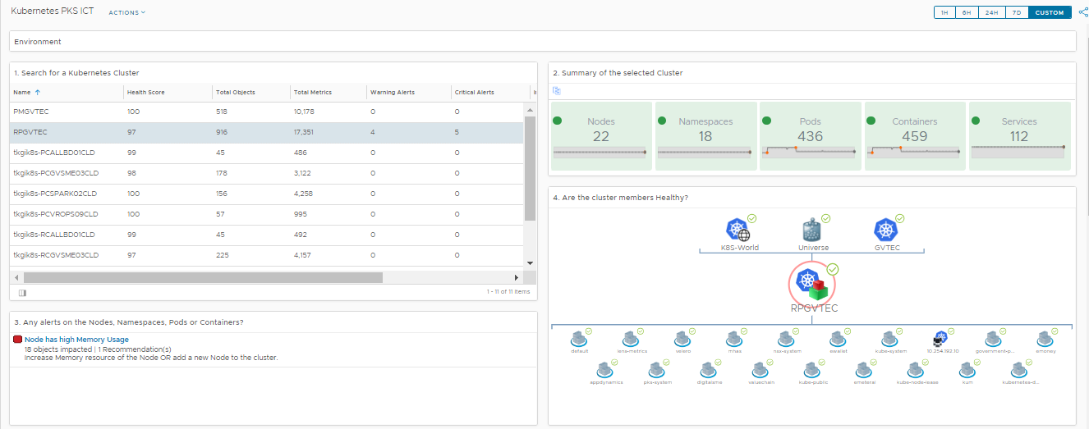
Availability RPGVTEC

Slide 12
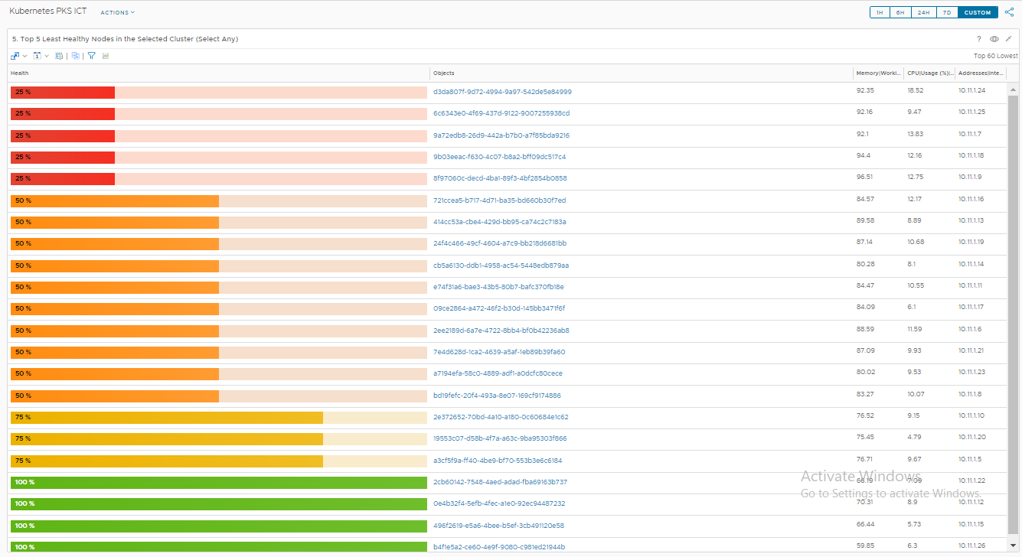
Health Status RPGVTEC
(Time Frame Satu Minggu)
Notes:
5 node mengalami alert Healthy Node < 35% ⚠, 8 node mengalami alert Healthy Node < 75% ⚠️

Slide 13
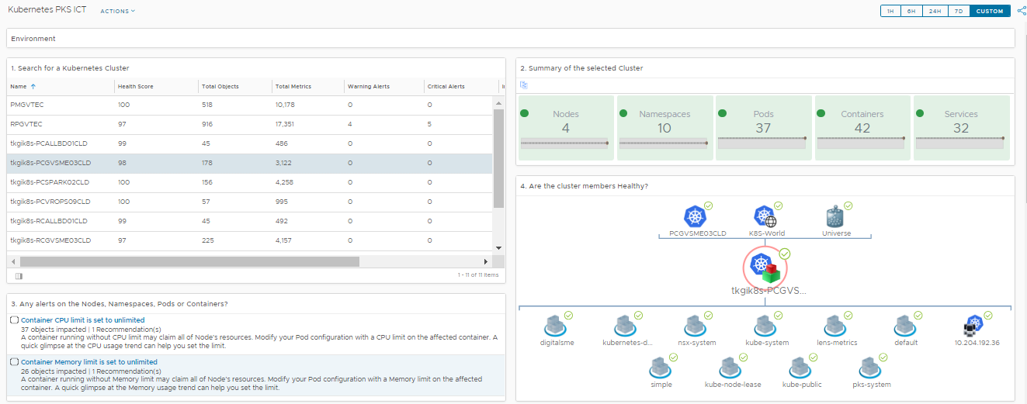
Availability PCGVSME03CLD

Slide 14
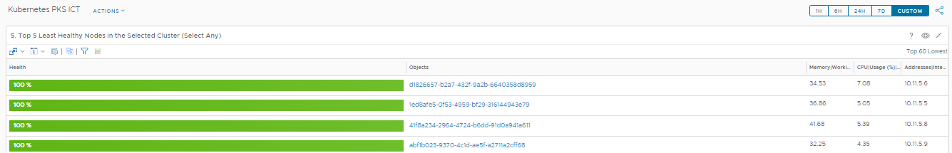
Health Status PCGVSME03CLD
(Time Frame Satu Minggu)

Slide 15
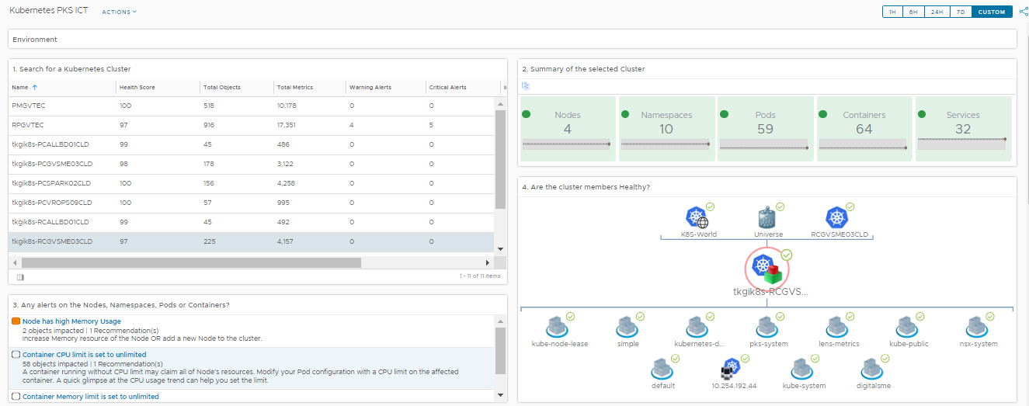
Availability RCGVSME03CLD

Slide 16
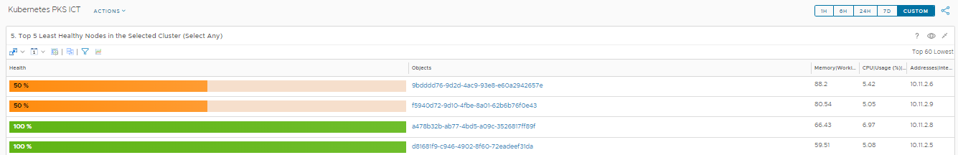
Health Status RCGVSME03CLD
(Time Frame Satu Minggu)
Notes:
1 node mengalami alert Healthy Node < 75% ⚠️

Slide 17
Capacity of resources

Slide 18
Datastore Cluster vCenter JKT01-WPAASDC
Datastore Name | Capacity | Capacity Remaining | Usage percentage | Keterangan
JKT01-PM-PAAS-DS01 | 3,91 TB | 48% | 52,4% | -
JKT01-PM-PAAS-DS02 | 3,91 TB | 44% | 55,9% | -
JKT01-PM-PAAS-DS03 | 3,91 TB | 45% | 55,1% | -
JKT01-PM-PAAS-DS04 | 3,91 TB | 47% | 52% | -
JKT01-RP-PAAS-DS01 | 3,91 TB | 54% | 44,1% | -
JKT01-RP-PAAS-DS02 | 3,91 TB | 47% | 51,1% | -
JKT01-RP-PAAS-DS03 | 3,91 TB | 51% | 47,3% | -
JKT01-RP-PAAS-DS04 | 3,91 TB | 38% | 63% | -

Slide 19
Datastore Cluster Dev vCenter rpdevwcaasvc01
Datastore Name | Capacity | Capacity Remaining | Usage Space | Keterangan
RV_PAASP_XB_HD21DND_001 | 4,09 TB | 32,7% | 66,6% | Capacity remaining sudah di bawah 35%
RV_PAASP_XB_HD21DND_002 | 4,09 TB | 35,1% | 64,7% | Capacity remaining sudah di bawah 35%

Slide 20
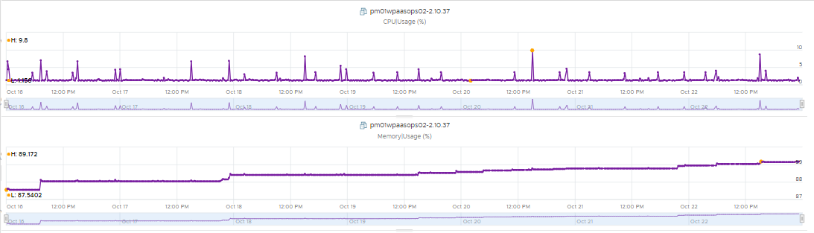
Ops Manager Plaza Mandiri
Ops Manager
CPU | Max | 9,8%
 | Min | 1,15%
Memory | Max | 89,17%
 | Min | 87,54%
Notes:
Note : Ops Manager dalam keadaan normal dan tidak ada alert

Slide 21
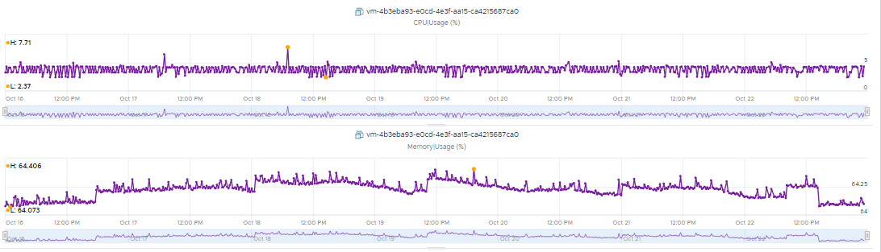
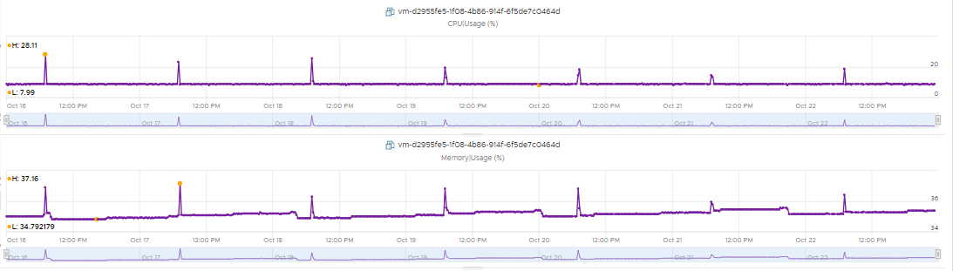
Tile BOSH Director & Harbor Plaza Mandiri
Bosh Director
CPU | Max | 7,71%
 | Min | 2,37%
Memory | Max | 64,40%
 | Min | 64,07%
Prest.Disk | Used Space | 58%
Harbor
CPU | Max | 28,11%
 | Min | 7,99%
Memory | Max | 37,16%
 | Min | 34,79%
Prest.Disk | Used Space | 15%
Notes:
Note : Tile Bosh dan Harbor dalam keadaan normal dan tidak ada alert

Slide 22
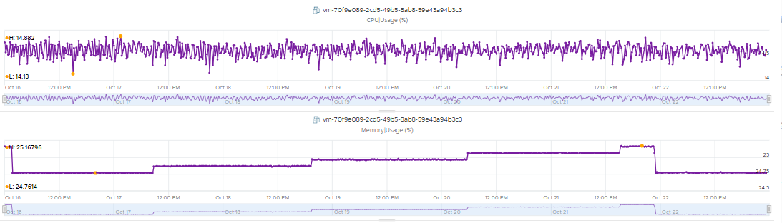
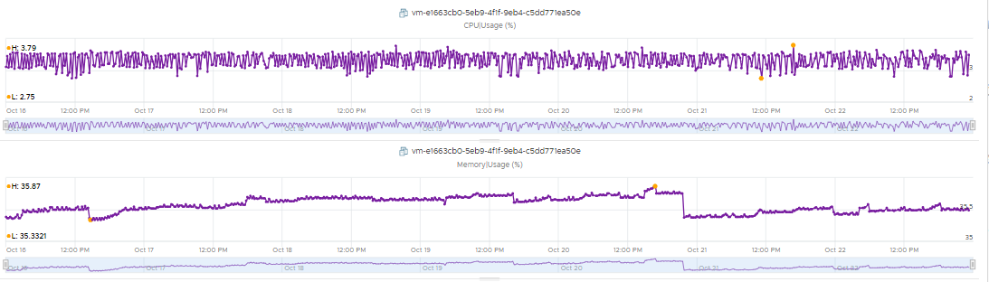
Tile TKGI Plaza Mandiri
TKGI Database
CPU | Max | 14,88%
 | Min | 14,13%
Memory | Max | 25,16%
 | Min | 24,76%
Prest.Disk | Used Space | 46%
TKGI API
CPU | Max | 3,79%
 | Min | 2,75%
Memory | Max | 35,87%
 | Min | 35,33%
Prest.Disk | Used Space | 21%
Notes:
Note : Tile TKGI Database dan TKGI API dalam keadaan normal dan tidak ada alert

Slide 23
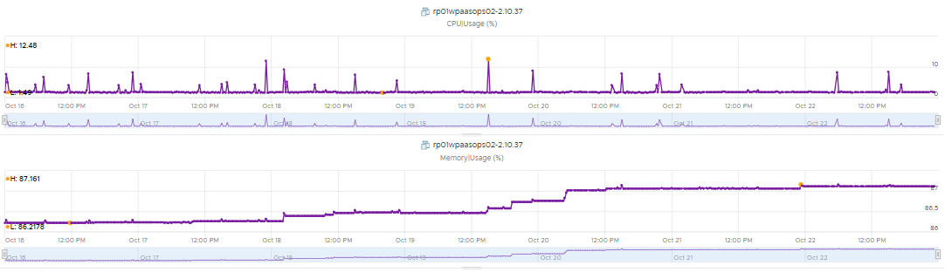
Ops Manager Rempoa
Ops Manager
CPU | Max | 12,48%
 | Min | 1,49%
Memory | Max | 87,16%
 | Min | 86,21%
Notes:
Note : Ops Manager dalam keadaan normal dan tidak ada alert

Slide 24
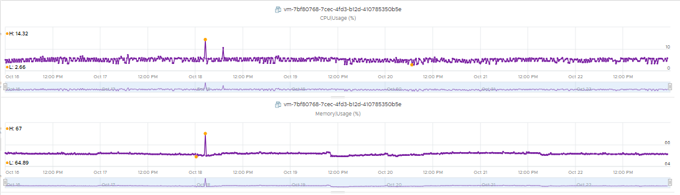
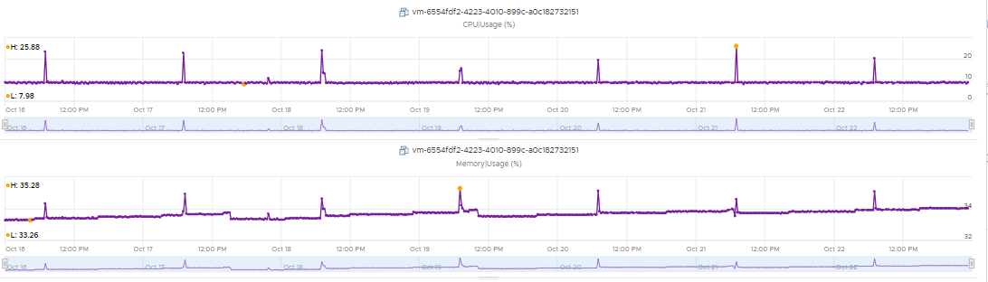
Tile BOSH Director & Harbor Rempoa
Bosh Director
CPU | Max | 14,32%
 | Min | 2,66%
Memory | Max | 67%
 | Min | 64,89%
Prest.Disk | Used Space | 61%
Harbor
CPU | Max | 25,88%
 | Min | 7,98%
Memory | Max | 35,28%
 | Min | 33,26%
Prest.Disk | Used Space | 15%
Notes:
Note : Tile Bosh dan Harbor dalam keadaan normal dan tidak ada alert

Slide 25
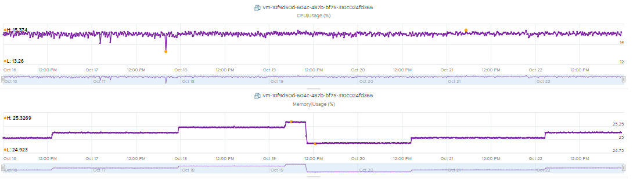
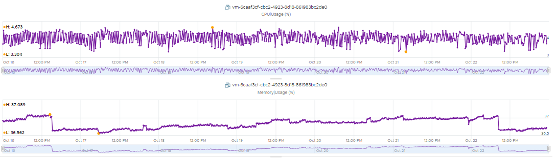
Tile TKGI Rempoa
TKGI Database
CPU | Max | 15,37%
 | Min | 13,26%
Memory | Max | 25,32%
 | Min | 24,92%
Prest.Disk | Used Space | 38%
TKGI API
CPU | Max | 4,67%
 | Min | 3.30%
Memory | Max | 37,08%
 | Min | 36,56%
Prest.Disk | Used Space | 21%
Notes:
Note : Tile TKGI Database dan TKGI API dalam keadaan normal dan tidak ada alert

Slide 26
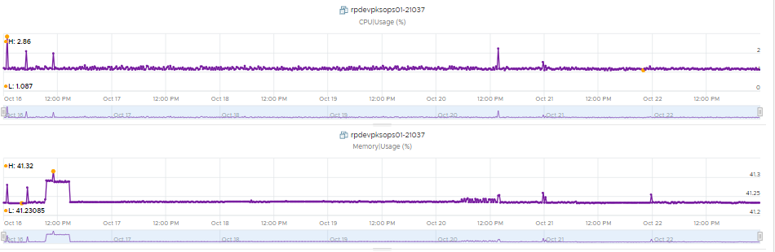
Ops Manager Rempoa Dev
Ops Manager
CPU | Max | 2,86%
 | Min | 1,08%
Memory | Max | 41,32%
 | Min | 41,23%
Notes:
Note : Ops Manager dalam keadaan normal dan tidak ada alert.

Slide 27
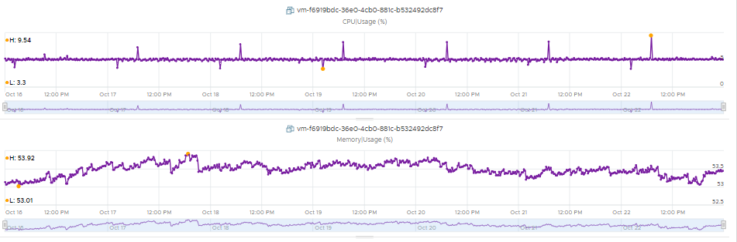
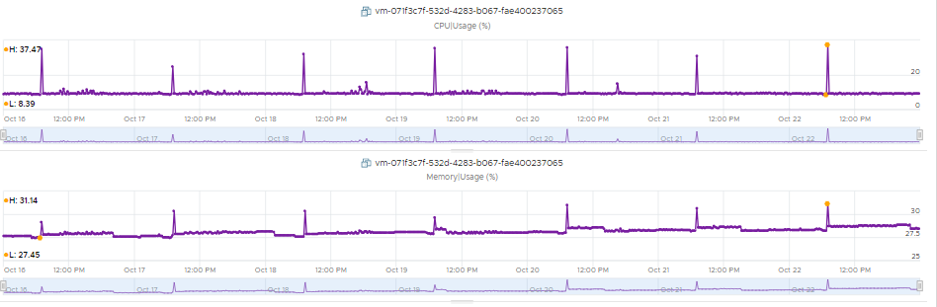
Tile BOSH Director & Harbor Rempoa Dev
Bosh Director
CPU | Max | 9,54%
 | Min | 3,3%
Memory | Max | 53,92%
 | Min | 53,01%
Prest.Disk | Used Space | 53%
Harbor
CPU | Max | 37,47%
 | Min | 8,39%
Memory | Max | 31,14%
 | Min | 27,45%
Prest.Disk | Used Space | 56%
Notes:
Note : Tile Bosh dan Harbor dalam keadaan normal dan tidak ada alert.

Slide 28
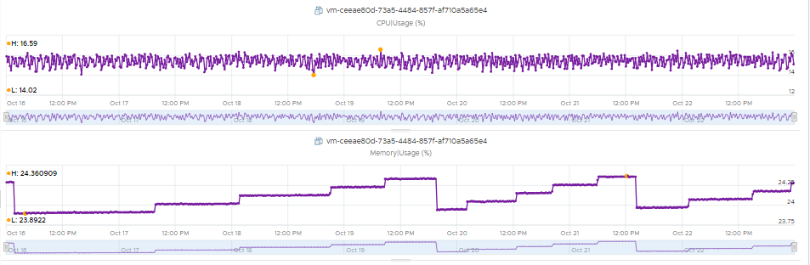
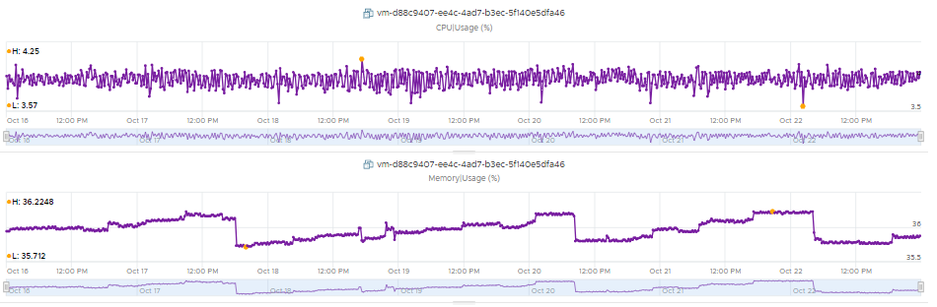
Tile TKGI Rempoa Dev
TKGI Database
CPU | Max | 16,59%
 | Min | 14,02%
Memory | Max | 24,36%
 | Min | 22,89%
Prest.Disk | Used Space | 33%
TKGI API
CPU | Max | 4,25%
 | Min | 3,57%
Memory | Max | 36,22%
 | Min | 35,71%
Prest.Disk | Used Space | 27%
Notes:
Note : Tile TKGI Database dan TKGI API dalam keadaan normal dan tidak ada alert.

Slide 29
Versioning

Slide 30
PKS/TKGI Current Version Production
Current Version
No | Produk | Version | Release Date | End of Support | Detail
1 | TKGI | 1.12.6-Build.3 | 2022-04-12 | 2022-09-30 | -
2 | Ops Manager | 2.10.37-Build.445 | 2022-04-07 | 2024-04-30 | -
3 | Bosh Director | 2.10.37-Build.445 | 2022-04-07 | 2024-04-30 | -
4 | Harbor | 2.4.1-Build.7 | 2021-12-18 | 2022-12-31 | -

Slide 31
PKS/TKGI Current Version Dev
Current Version
No | Produk | Version | Release Date | End of Support | Detail
1 | TKGI | 1.12.6-Build.3 | 2022-04-12 | 2022-09-30 | -
2 | Ops Manager | 2.10.37-Build.445 | 2022-04-07 | 2024-04-30 | -
3 | Bosh Director | 2.10.37-Build.445 | 2022-04-07 | 2024-04-30 | -
4 | Harbor | 2.4.1-Build.7 | 2021-12-18 | 2022-12-31 | -

Slide 32
PKS/TKGI Release Note
Release Note
No | Produk | Target Version For Upgrade |  |  | Latest Version |  |  | Detail
 |  | Version | Release Date | End of Support | Version | Release Date | End of Support
1 | TKGI | 1.13.9-build.11 | 2022-11-01 | 2023-02-28 | 1.17.1-build.14 | 2023-09-14 | 2024-08-31 | -
2 | Ops Manager | 2.10.56-build.762 | 2023-04-10 | 2024-04-30 | 3.0.15-build.922 | 2023-09-12 | 2025-03-31 | -
3 | Bosh Director | 2.10.56-build.762 | 2023-04-10 | 2024-04-30 | 3.0.14-build.712 | 2023-07-27 | 2025-03-31 | -
4 | Harbor | 2.4.1 | 2021-12-18 | 2022-12-31 | 2.9.0 | 2023-09-15 | 2024-09-30 | -
Notes:
Target version akan berubah apa bila ada plan upgrade.

Slide 33
Last week issues and changes

Slide 34
Last week issue and changes
No | Incident / Activity | Description | Ticket Number | Issue Date | Solved Date | PIC | Status | Note
1 | Kendala gagal upload | User melakukan promote landing page terkait dengan perubahan config dari level nginx service FE ke level ingress pks namun masih gagal pada configuration nya | SR 22348546207 | 23 Juli 2022 | - | Mandiri : Aristyo ICT : ICT Devops Principal: VMware Team | Planning | Untuk plan, sudah dilakukan Meeting Dengan team Vmware dan akan dilakukan meeting Lanjutan Dengan team vmware.
2 | Healthy Node di beberapa node yang terjadi pada cluster GVTEC Rempoa Prod dan cluster GVSME03CLD Rempoa Prod | Healthy Node terjadi di karenakan node tersebut sedang mengalami High Memory Usage | - | 5 Des 2022 | - | Mandiri : Aristyo ICT : ICT Devops Principal: VMware Team | In Progress | Informasi ini juga sudah di sampaikan dalam Daily Report
Notes:
Action terakhir sudah dilakukan meeting bersama tim user terkait, dan untuk kesimpulan nya belum di temukan jadi untuk sementara configuration dari apps dikembalikan seperti semula.

Slide 35
Plan Next Activity PKS dan NSX-T
No | Activity | Description | Plan Date | Execute Date | PIC | Status | Note
1 | Menyamakan Topology NSX-T Dev dengan NSX-T Prod | Menyamakan Topology NSX-T Dev dengan NSX-T Prod, karena saat ini terdapat perbedaan Topologi antara NSX-T Dev dan NSX-T Prod dan yang akan dijadikan acuan adalah NSX-T Prod | - | - | Mandiri : Aristyo ICT : ICT Devops Principal: VMware Team | On Going | Masih menunggu dari pihak vmwarenya

Slide 36
Any Infromation Correlated With Kubernetes Cluster
Terdapat alert critical, immediate dan warning High Memory Usage di 18 node dari 22 node yang ada pada Cluster RPGVTEC.
Terdapat alert immediate High Memory Usage di 2 node dari 4 node yang ada pada Cluster RCGVSME03CLD.

Slide 37
Recommendation
TKGI
Membuat replikasi yang lebih dari satu, pada deployment - deployment di masing - masing Cluster (PMGVTEC, RPGVTEC, PCGVSME03CLD dan RCGVSME03CLD) untuk menghindari Single Point of Failure.

Slide 38
Thank You
for
Your Attention

